Slide 1
FY2027-2028 Budget Workshop Proposed Schedule
Wednesday, September 30, 2026 | 8:30 a.m.
Water, Wastewater and Stormwater Operating and Capital Budgets
Proposed Rules and Regulation Changes and Fee Adjustments
Wednesday, November 04, 2026 | 6:00 p.m.
Workshop # 2 Community Feedback
Wednesday, January 13, 2027 | 8:30 a.m.
PSB Regular Meeting: Approve and adopt budgets, rate adjustments, and Rules and Regulations

Slide 2
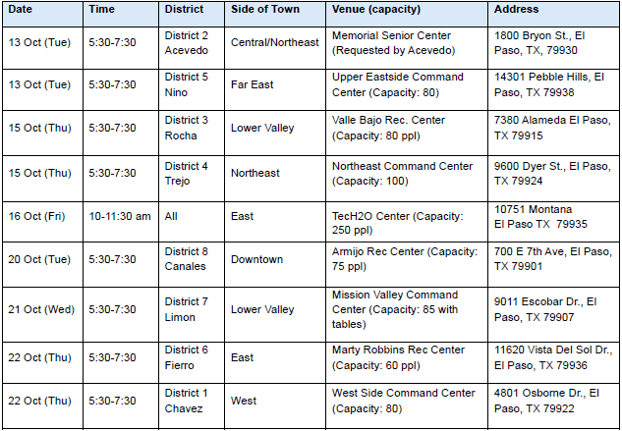
Fiscal Year 2027-2028 Community Meetings

